Slide 1
Object Oriented Programming with Java
Day 10

Slide 2
Learning About Exceptions
Exceptions
Unexpected or error conditions
Not usual occurrences
Causes:
The program issues a call to a file that does not exist
The program attempts to write to a full disk
The user enters invalid data
The program attempts to divide a value by 0
Objects
Descend from the Throwable class
Exception handling
Object-oriented techniques used to manage Exception errors
Runtime exceptions

Slide 3
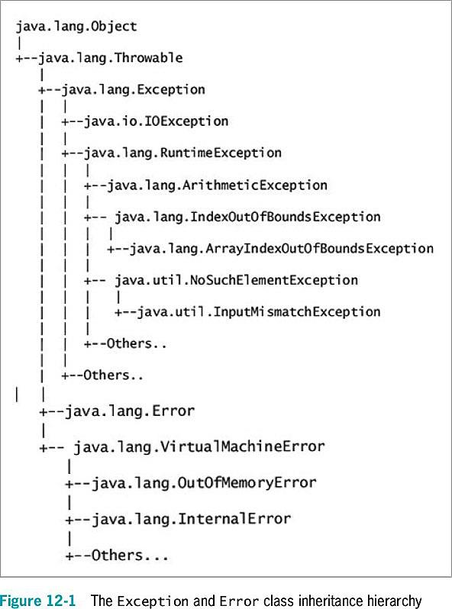

Slide 4
Learning About Exceptions
Error class
Represents serious errors from which a program usually cannot recover
Error conditions
A program runs out of memory
A program cannot locate a required class
Exception class
Less serious errors
Unusual conditions
A program can recover from this type of error
Exception conditions
An invalid array subscript
Performing illegal arithmetic operations

Slide 5
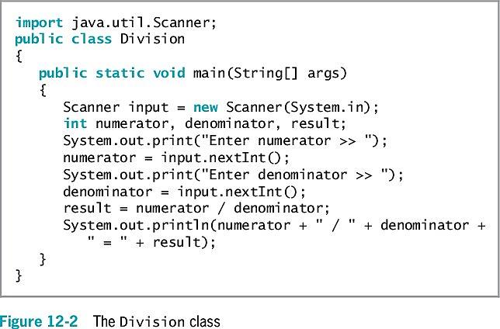
Learning About Exceptions
What happens if the user enters 0 as a denominator?

Slide 6
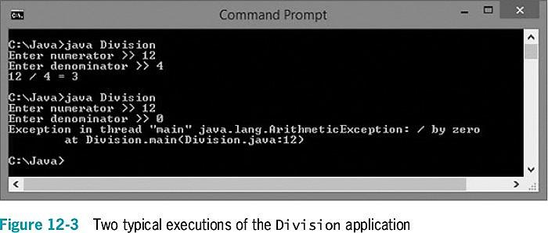
Learning About Exceptions

Slide 7
Learning About Exceptions
You do not necessarily have to deal with an exception
Let the offending program terminate
But doing so is abrupt and unforgiving
You can write programs without using exception-handling techniques
Use a decision to avoid an error
Exception handling provides a more elegant solution for handling error conditions

Slide 8
Learning About Exceptions
Fault-tolerant
Designed to continue to operate when some part of the system fails
Robustness
Represents the degree to which a system is resilient to stress

Slide 9
Trying Code and Catching Exceptions
try block
A segment of code in which something might go wrong
Attempts to execute
Acknowledges an exception might occur
A try block includes:
The keyword try
Opening and closing curly braces
Executable statements, which might cause an exception
catch block
A segment of code
Immediately follows a try block
Handles an exception thrown by the try block preceding it
Can “catch” an Object of type Exception or an Exception child class
throw statement
Sends an Exception object out of a block or method so it can be handled elsewhere

Slide 10
Trying Code and Catching Exceptions
A catch block includes:
The keyword catch
Opening and closing parentheses
An Exception type
A name for an instance of the Exception type
Opening and closing curly braces
Statements to handle the error condition

Slide 11
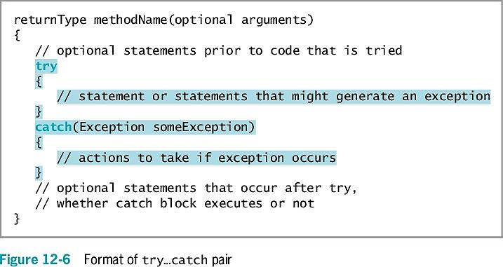
Trying Code and Catching Exceptions

Slide 12
Trying Code and Catching Exceptions
If no exception occurs within the try block, the catch block does not execute
getMessage() method
Obtains information about the exception
Within a catch block, you might want to add code to correct the error

Slide 13
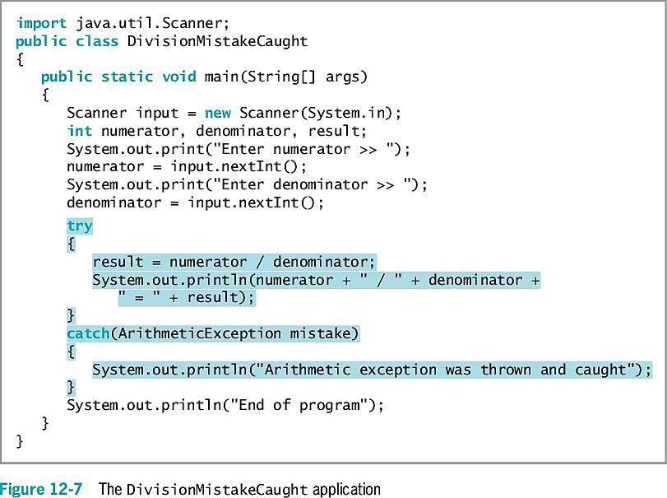
Trying Code and Catching Exceptions

Slide 14
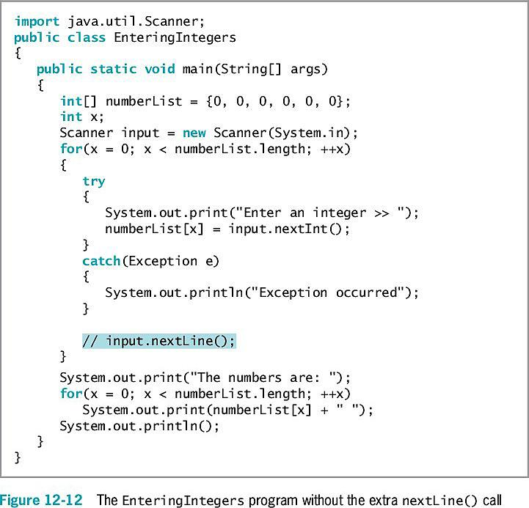
Using a try Block to Make Programs “Foolproof”
It is useful to circumvent data entry errors
Handle potential data conversion exceptions caused by careless users
Using a nextLine() call will account for potential remaining characters in the input buffer

Slide 15
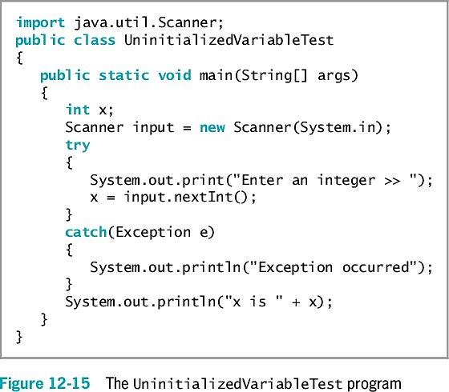
Declaring and Initializing Variables in try…catch Blocks
A variable declared within a block is local to that block
It goes out of scope when the try or catch block ends
If the conversion fails, an exception is thrown
Review the code snippet on your right.
Will this code compile?
Which line in this code snippet has an error?

Slide 16
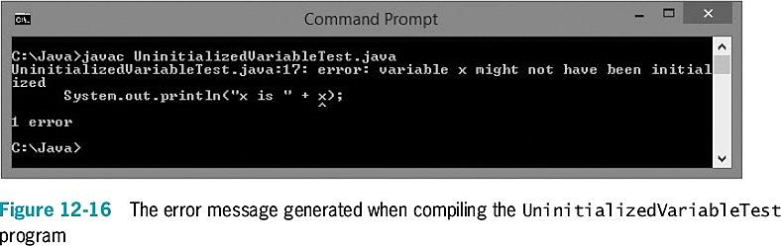
Declaring and Initializing Variables in try…catch Blocks

Slide 17
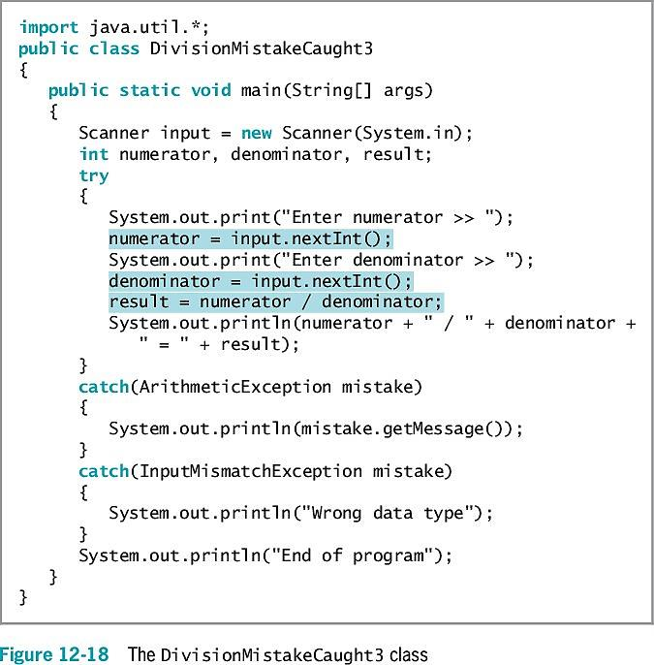
Throwing and Catching Multiple Exceptions
You can place multiple statements within a try block
Only the first error-generating statement throws an exception
When a program contains multiple catch blocks:
They are examined in sequence until a match is found for the Exception type
The matching catch block executes
Each remaining catch block is bypassed

Slide 18
Throwing and Catching Multiple Exceptions
“Catch-all” block
Accepts a more generic Exception argument type:
catch(Exception e)
Unreachable code
Program statements that can never execute under any circumstances
In Java 7 and 8, a catch block can also be written to catch multiple Exception types
It is poor style for a method to throw more than three or four Exception types

Slide 19
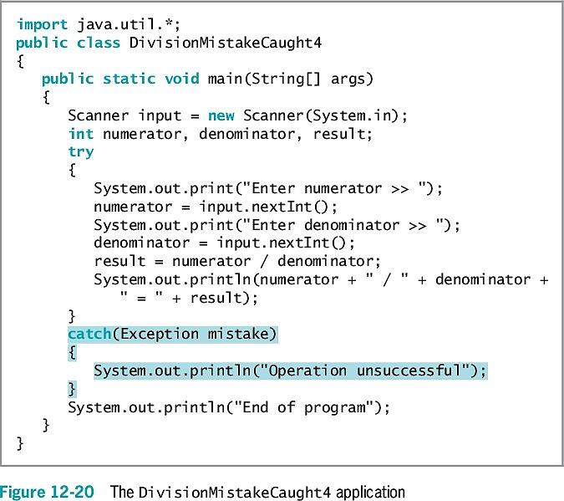

Slide 20
Exercise
Write an application that throws and catches an ArithmeticException when you attempt to take the square root of a negative value. Prompt the user for an input value and try the Math.sqrt() method on it. The application either displays the square root or catches the thrown Exception and displays an appropriate message.

Slide 21
Using the finally Block
finally block
Use for actions you must perform at the end of a try…catch sequence
Use to perform cleanup tasks
Executes regardless of whether the preceding try block identifies an exception

Slide 22
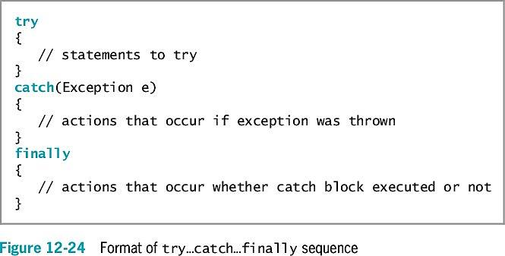
Using the finally Block

Slide 23
Using the finally Block
When the try code fails:
It throws an exception
The Exception object is caught
The catch block executes
The finally block executes
Control passes to statements at the end of the method
Reasons the final set of statements might never execute:
An unplanned exception might occur
The try or catch block might contain a System.exit(); statement
The try block might throw an Exception object for which you did not provide a catch block
Program execution stops immediately
The exception is sent to the operating system for handling
The current method is abandoned

Slide 24
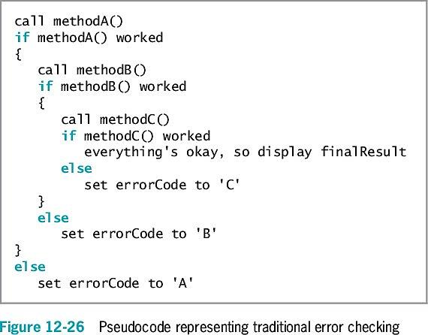
Understanding the Advantages of Exception Handling
Before object-oriented programming languages, errors were handled with confusing, error-prone methods
When any method fails, the program sets appropriate error code
Difficult to follow
The application’s purpose and intended outcome are lost in a maze of if statements
Coding mistakes are made because of complicated nesting

Slide 25
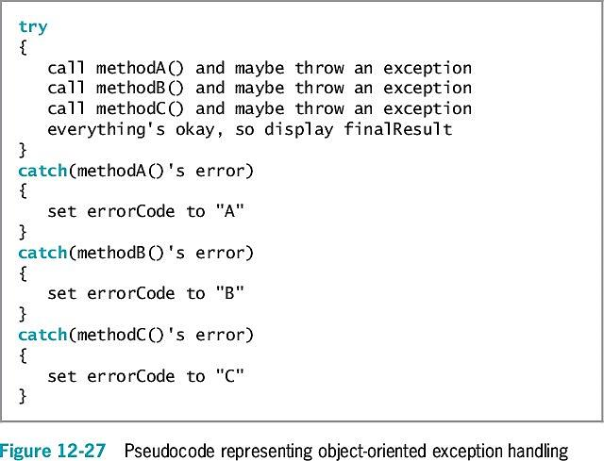
Understanding the Advantages of Exception Handling

Slide 26
Understanding the Advantages of Exception Handling
Java’s object-oriented, error-handling technique
Statements of the program that do the “real” work are placed together, where their logic is easy to follow
Unusual, exceptional events are grouped and moved out of the way
An advantage to object-oriented exception handling is flexibility in handling of error situations
Appropriately deal with exceptions as you decide how to handle them

Slide 27
Specifying the Exceptions That a Method Can Throw
If a method throws an exception that it will not catch but will be caught by a different method, use the keyword throws followed by the Exception type in the method header
Exception specification
Lists exceptions that a method may throw
Every Java method has the potential to throw an exception
For most Java methods, do not use the throws clause
Let Java handle any exception by shutting down the program
Most exceptions never have to be explicitly thrown or caught

Slide 28
Specifying the Exceptions That a Method Can Throw
Unchecked exceptions
Inherit from the Error class or the RuntimeException class
You are not required to handle these exceptions
You can simply let the program terminate
An example is dividing by zero
Checked exceptions
Programmers should anticipate checked exceptions
Programs should be able to recover from them

Slide 29
Specifying the Exceptions That a Method Can Throw
If you throw a checked exception from a method, you must do one of the following:
Catch it
Declare the exception in the method header’s throws clause
To use a method to its full potential, you must know:
Method’s name
Method’s return type
Type and number of arguments the method requires
Type and number of exceptions the method throws

Slide 30
Tracing Exceptions Through the Call Stack
Call stack
The memory location where the computer stores the list of method locations to which the system must return
When a method throws an exception:
The exception is thrown to the next method up the call stack
Methods are allowed to handle exceptions wherever the programmer has decided it is most appropriate
Including allowing the operating system to handle the error

Slide 31
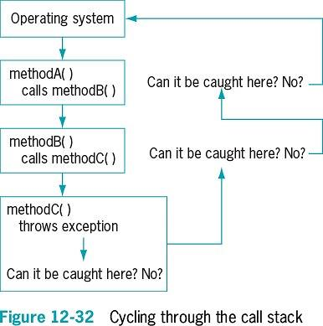
Tracing Exceptions Through the Call Stack

Slide 32
Tracing Exceptions Through the Call Stack
printStackTrace() method
Displays a list of methods in the call stack
Determines the location of an exception
Is not placed in a finished program
Most useful for diagnosing problems

Slide 33
Creating Your Own Exception Classes
Java provides over 40 categories of Exceptions
Java allows you to create your own Exception classes
Extend a subclass of Throwable
Exception class constructors:
Exception()
Exception(String message)
Exception(String message, Throwable cause)
Exception(Throwable cause)

Slide 34
Exercise
Write an application that displays a series of at least 10 student ID numbers (stored in an array) and ask the user to enter a test letter grade for the student. Create an Exception class named GradeException that contains a static public array of valid grade letters (‘A’, ‘B’, ‘C’, ‘D’, ‘F’ and ‘I’) that you can use to determine whether a grade entered from the application is valid. In your application throw a GradeException if the user does not enter a valid letter grade. Catch the GradeException and then display an appropriate message. In addition, store an ‘I’ (Incomplete) for any student for whom an exception is caught. At the end of the application, display all the student IDs and grades.

Slide 35
Using Assertions
Assertion
A Java language feature
Detects logic errors
Debugs programs
assert statement
Creates an assertion, such as:
assert booleanExpression : optionalErrorMessage
The Boolean expression in the assert statement should always be true if the program is working correctly

Slide 36
Using Assertions
An AssertionError is thrown when a condition is false
To enable an assertion, you must use the -ea option when executing a program

Slide 37
Displaying the Virtual Keyboard
A virtual keyboard is a computer keyboard that appears on the screen
Allows user to point to and click keys with a mouse
With a touch screen user can touch keys with finger or stylus

Slide 38
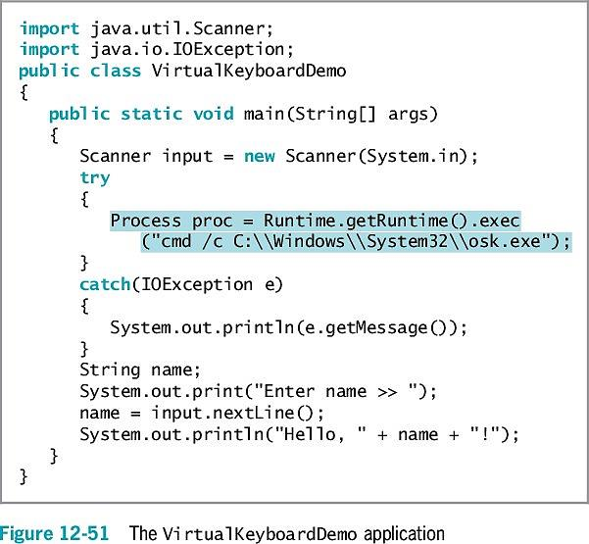

Slide 39
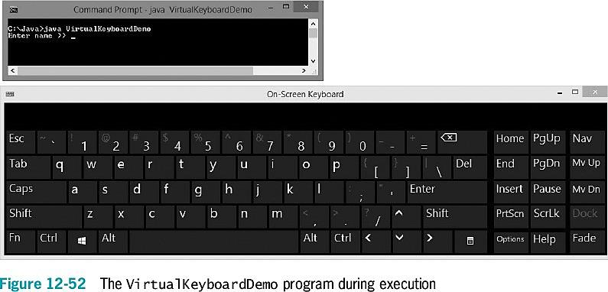

Slide 40
Don’t Do It
Don’t forget that all the statements in a try block might not execute
Don’t forget that a variable declared in a try block goes out of scope at the end of the block
Don’t forget that when a variable gets its usable value within a try block, you must ensure that it has a valid value before attempting to use it
Don’t forget to place more specific catch blocks before more general ones
Don’t forget to write a throws clause for a method that throws an exception but does not handle it
Don’t forget to handle any checked exception thrown to your method

Slide 41
Summary
Exception
An unexpected or error condition
Exception handling
Object-oriented techniques to manage errors
Basic classes of errors: Error and Exception
Exception-handling code
try block
catch block
finally block

Slide 42
Summary
Use the throws <name>Exception clause after the method header
Indicate the type of exception that might be thrown
Call stack
A list of method locations to which the system must return
Java provides over 40 categories of Exceptions
Create your own Exception classes
Assertion
State a condition that should be true
Java throws an AssertionError when it is not

Slide 43
Exercise
Open the files in the “WA140 - Day10 Debugging Exercises.zip” archive. Each of these files has syntax and/or logic errors. In each case, determine the problem and fix the program. After you correct the errors, save each file usin gthe same filename preceded with “Fix”. For example, DebugTwelve1.java will become FixDebugTwelve1.java. You will also use the file named DebugEmployeeIDException.java with DebugTwelve4.java.
Discuss in class what syntax and logic errors you found, and how you fixed them.

